Slide 1
ES 200: Autumn 2020
Environmental Studies : Science and Engineering
Module C: Solid Waste Management
Prof. Tabish Nawaz (Module C)
(tnawaz@iitb.ac.in)
Environmental Science and Engineering Dept.,
IIT Bombay
* Instructor In-Charge
(vsethi@iitb.ac.in)

Slide 2
Module C
Solid Waste Management
Lecture-6 Topics
MSW Processing Techniques
Thermal Methods
MSW Ultimate Disposal
Sanitary Landfilling

Slide 3
Thermal Processes for recovery of conversion products from MSW
Process | Conversion product | Preprocessing
Combustion (incineration) | Energy in form of electricity or steam | None in mass-fired incinerator; preparation of RDF for suspension or semi-suspension firing in boilers
Gasification | Low-energy gas | Separation of the organic fraction, particle size reduction, preparation of fuel cubes/other RDF
Wet oxidation | Organic acids | Separation of the organic fraction, particle size reduction, preparation of fuel cubes/other RDF
Steam reforming | Medium-energy gas | Separation of the organic fraction, particle size reduction, preparation of fuel cubes/other RDF
Pyrolysis | Medium-energy gas, liquid fuel, solid fuel (char) | Separation of the organic fraction, particle size reduction, preparation of fuel cubes/other RDF
Hydrogenation/hydrogasification | Medium-energy gas, liquid fuel | Separation of the organic fraction, particle size reduction, preparation of fuel cubes/other RDF

Slide 4
Combustion
As the principal elements of MSW are C, H, O, N, S; under ideal conditions, when combusted, the gaseous end-products are CO₂, H₂O, N₂, and SO₂.
In practice, other gaseous compounds are formed depending on operating conditions, under which combustion process is occurring.
Combustion calculations are based on the following fundamental laws:
Conservation of mass
Conservation of energy
Gas law: volume of gas is directly proportional to its absolute temperature and inversely proportional to its absolute pressure
Law of combining masses: all substances combine in accordance with a definite, simple relationship to relative masses

Slide 5
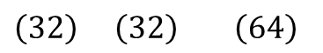
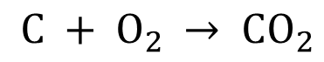

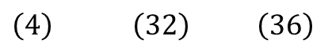
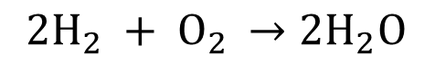
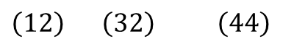
Air Requirements for Combustion
To determine the amount of oxygen required for the complete combustion of MSW, it is necessary to compute the oxygen requirements for the oxidation of C, H, and S contained in the waste.
The basic reactions are:
$${ C + O}_{2} → CO_{2}$$
$${ 2H_{2} + O}_{2} →2H_{2}O$$
$${ S + O}_{2} →SO_{2}$$
$\left(12\right) \left(32\right)$ $\left(44\right)$
$\left(4\right) \left(32\right)$ $\left(36\right)$
$\left(32\right) \left(32\right)$ $\left(64\right)$
In combustion calculations, the oxygen requirements for the combustion of hydrogen are based on the net value of hydrogen available. (net value of hydrogen is computed by subtracting 1/8th of the % oxygen from the total percentage of hydrogen present initially)
The heat released from the combustion of MSW is partly stored in the products (gas and ash) and partly transferred by convection, conduction or radiation to the incinerator walls, and to the incoming waste.

Slide 6
Gasification
Gasification involves partial combustion of a carbonaceous fuel to generate combustible fuel gas, rich in carbon monoxide and hydrogen.
A gasifier is basically an incinerator operating under reducing conditions (or less than stoichiometric amount of oxygen).
When a gasifier is operated at atmospheric pressure with air as the oxidant, end products are low-energy gas (5.2 to 6 MJ/m³) typically containing (by volume), 10% CO₂, 20% CO, 15% H₂ and 2% CH₄.
When pure oxygen is used as the oxidant, end products are medium-energy gas (12.9 to 14 MJ/m³).
Heat to sustain the process is derived from the exothermic reactions while the combustible components of the low-energy gas are primarily generated by the endothermic reactions
Gasification can be done by two methods: Partial oxidation, very similar to combustion, except that it occurs with insufficient oxygen supply (or) indirectly heated in the absence of oxygen or air, with steam as the oxidizing agent.

Slide 7
Gasification
The product of gasification is either syngas or producer gas:
Syngas: Mixture of Carbon Monoxide and Hydrogen which is the product of steam or oxygen gasification of organic material. Syngas is the term generally used for mixture of combustible gases. So typically a syngas mixture will constitute of only hydrogen and carbon monoxide, with possibility of having carbon dioxide content sometimes.
Producer gas: A mixture of combustible (Hydrogen, Methane and Carbon Monoxide) and non-combustible (Nitrogen, Carbon dioxide) gases. The heating value of producer gas varies from 4.5 to 6 MJ/m³.
Higher quality syngas can be produced by indirect heating or by using pure oxygen as the oxidizing agent.
Producer gas results if air is used as the oxidizing agent, which dilutes the combustible components of the gas with nitrogen.

Slide 8
Pyrolysis
Upon heating in an oxygen free atmosphere, most organic substances, can be split through a combination of thermal cracking and condensation reactions into: gaseous, liquid and solid fractions. Pyrolysis is the term used to describe this process.
In contrast to the combustion process, which is highly exothermic, the pyrolytic process is highly endothermic. For this reasons, destructive distillation is the alterative term for pyrolysis.
3 major component fractions result from pyrolysis of MSW:
Gas stream containing primarily H₂, CH₄, CO, CO₂ and other gases depending on the organic characteristics of the raw material.
A fraction consisting of tar and/or oil stream that is liquid at room temperature and has been found to contain acetic acid, acetone and methanol.
A char that consisting almost pure carbon plus any inert material that may have entered the process.

Slide 9
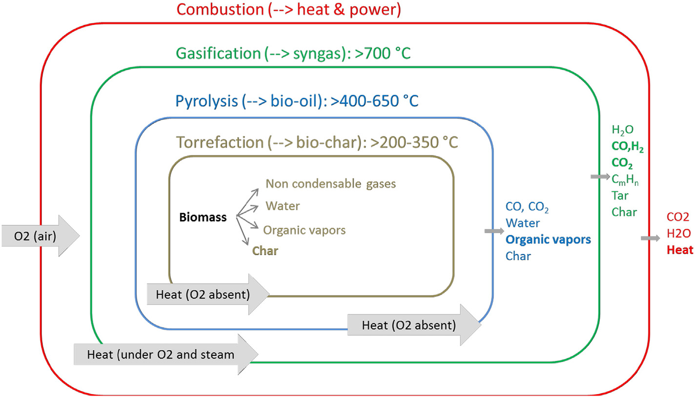
Pyrolysis
Distribution of product fractions in pyrolysis varies with the temperature at which pyrolysis is carried out.
Under conditions of maximum gasification, the energy content of resulting gas is about 26.1 MJ/m³.
The energy content of pyrolytic oils is estimated to be around 23.2 MJ/kg.
Torrefaction is a mild and slow pyrolysis, conducted at temperatures ranging between 200ºC and 350ºC.
Comparison of Thermal Conversion Processes
Matsakas, Leonidas & Gao, Qiuju & Jansson, Stina & Rova, Ulrika & Christakopoulos, Paul. (2017). Green conversion of municipal solid wastes into fuels and chemicals.
Electronic Journal of Biotechnology. 26. 10.1016/j.ejbt.2017.01.004.

Slide 10
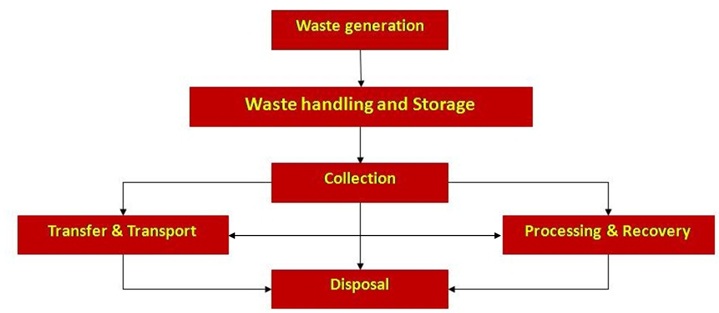
Functional elements of a solid waste management system

Slide 11
Sanitary Landfill
Landfilling involves the controlled disposal of MSW on or in the upper layer of the earth’s mantle.
Important aspects in the implementation of sanitary landfills include:
Site Selection
Landfilling methods and operations
Occurrence of gases and leachates* in landfills
Movement and control of landfill gases and leachate
*Leachate: liquid that has percolated through solid waste and has extracted dissolved or suspended materials
Produced from decomposition of wastes
Entered landfill from external sources such as rainfall

Slide 12
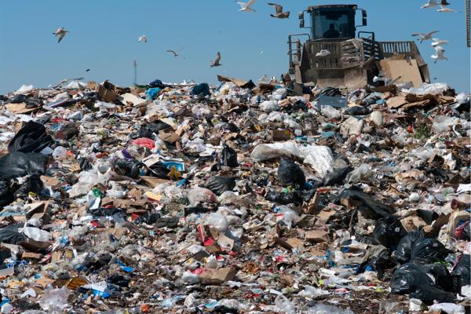
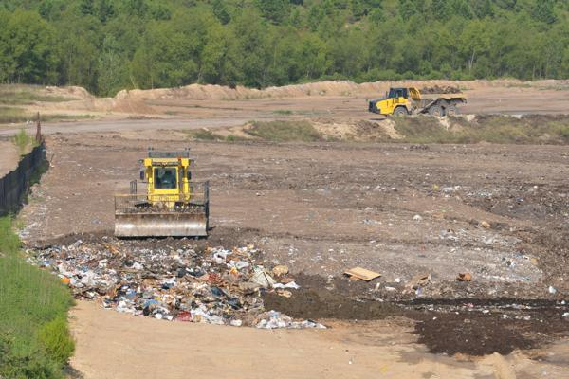
Open Dumping vs Sanitary Landfill
Open Dump | Landfill
It refers to the land site where piles of garbage are accumulated. | It refers to the land site designed for waste management.
No monitoring or treatment is involved, which results in foul odor. This attracts rats, rodents, and other pests. | The whole process is carefully monitored, and leachate collection and treatment/lining is involved for environmental protection.
An open dump can be located anywhere, and are hazardous to the environment. | Setting up a landfill requires a fixed type of location, and certain factors need to be considered for maximum level of protection.

Slide 13
What can/not be Landfilled
Types of MSW suitable for sanitary landfills
Non-biodegradable and inert waste by nature or through pretreatment
Commingled waste not found suitable for waste processing
Pre/post-processing rejects from waste processing sites
Non-hazardous waste not being processed or recycled
Types of MSW not suitable for Sanitary landfilling:
Biodegradable waste or garden waste
Dry recyclables
Hazardous waste or industrial waste
Construction and demolition waste

Slide 14
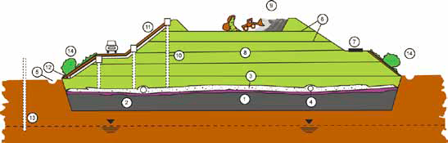
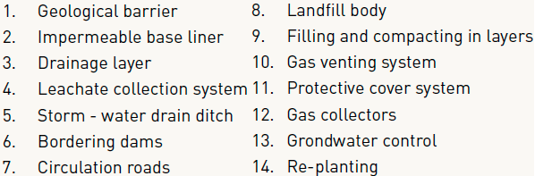
Components of a Sanitary Landfill
Manual on Municipal Solid Waste Management – 2016, Central Public Health & Environmental Engineering Organization (CPHEEO)

Slide 15
Essential Components of a Sanitary Landfill
A liner system at the base and sides of the sanitary landfill which prevents migration of leachate or gas to the surrounding soil.
A leachate collection and control facility which collects and extracts leachate from within and from the base of the sanitary landfill and then treats the leachate.
A gas collection and control facility which collects and extracts gas from within and from the top of the sanitary landfill and then treats it or uses it for energy recovery.
A final cover system at the top of the sanitary landfill which enhances surface drainage, prevents infiltrating water, and supports surface vegetation.
Manual on Municipal Solid Waste Management – 2016, Central Public Health & Environmental Engineering Organization (CPHEEO)

Slide 16
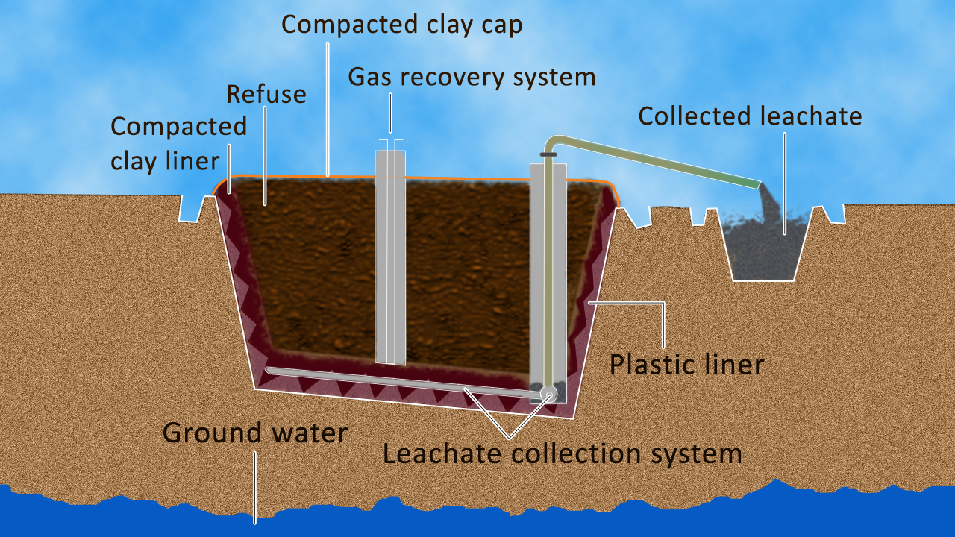
Essential Components of a Sanitary Landfill
A surface water drainage system which collects and removes all surface runoff from the sanitary landfill site.
An environmental monitoring system which periodically collects and analyses air, surface water, soil, gas, and groundwater samples around the sanitary landfill site.
Typical Landfill
Manual on Municipal Solid Waste Management – 2016, Central Public Health & Environmental Engineering Organization (CPHEEO)

Slide 17
Site Selection for Sanitary Landfill
Factor | Criteria
Available land area | Site should have a useful life greater than 1-year (minimum value)
Haul distance | Will have a significant impact on operating costs
Soil conditions and topography | Cover material should be available at or near the site
Surface water hydrology | Impacts drainage requirements
Geological and hydrogeological conditions | Most important factor, especially with respect to site preparation
Climatologic conditions | Provision must be made for wet-weather operation
Local environmental conditions | Noise, odor, dust, vector ad aesthetic control requirements
Ultimate use of site | Affects long-term management for site

Slide 18
Landfilling Methods and Operations
Principal methods used for landfilling:
Area
Trench
Depression
Area Method:
Used when terrain is unsuitable for excavation
Filling operation is started by building an earthen levee against which wastes are placed in thin layers and compacted.
Each layer is compacted as the filling progresses until the thickness of the compacted wastes reaches a height varying from 2 -3 m
At the end of each day’s operation, a 150 to 300 mm layer of cover material is placed over the completed fill.

Slide 19
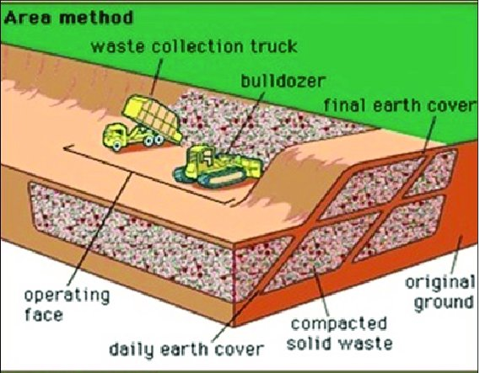
Landfilling Methods and Operations
The cover material must be hauled in by truck or earth-moving equipment from adjacent land or from borrow-pit areas.
A completed lift, including the cover material is called a cell.
Successive lifts are placed on top of one another until the final grade called for in the ultimate development plan in reached.
A final layer of cover material is used when the fill reaches the final design height.

Slide 20
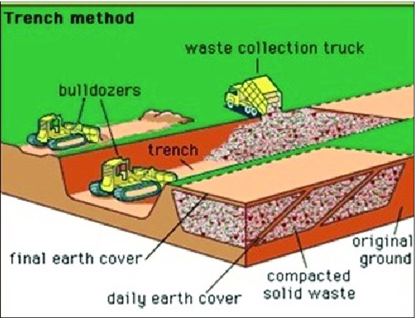
Landfilling Methods and Operations
Trench Method:
Ideally suited to areas where an adequate depth of cover material is available and the site and where water table is below the surface.
To start the process, a portion of the trench is dug with a bulldozer and the dirt is stockpiled to form an embankment behind the first trench.
Wastes are then placed in the trench, spread into thin layers and compacted.
The operation continues until the desired height is reached.
Cover material is obtained by excavating an adjacent trench or continuing the trench that is being filled.

Slide 21
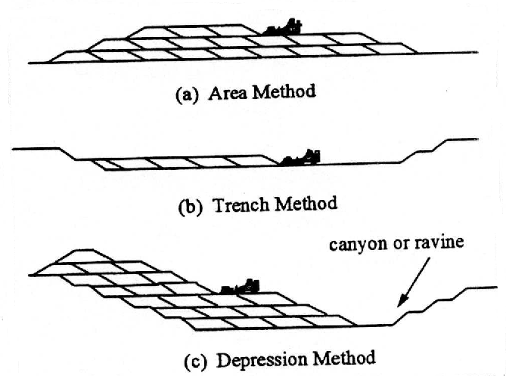
Landfilling Methods and Operations

Slide 22
Occurrence of Gases and Leachate
The following biological, physical, and chemical events occur when solid wastes are placed in a sanitary landfill:
Biological decay of organic materials, with the evolution of gases and liquids
Chemical oxidation of waste materials
Escape of gases from the fill
Movement of liquids caused by differential heads
Dissolving and leaching of organic and inorganic materials by water and leachate moving through the fill
Movement of dissolved material by concentration gradients and osmosis
Uneven settlement caused by consolidation of materials into voids

Slide 23
Occurrence of Gases in Landfills
Gases found in landfills include ammonia, carbon dioxide, carbon monoxide, hydrogen, hydrogen sulfide methane, nitrogen, and oxygen.
CO₂ and CH₄ are the principal gases produced from anaerobic decomposition of organic solid waste compounds.
Anaerobic conversion in landfills occurs in 3 steps:
Enzyme-mediated transformation (liquefaction) of higher molecular weight compounds into suitable for use as a source of energy and cell carbon
Bacterial conversion of the compounds from 1st step into identifiable lower-molecular weight intermediate compounds
Bacterial conversion of intermediate compounds inti simpler end-products such as CO₂ and CH₄

Slide 24
Occurrence of Gases in Landfills
The overall anaerobic conversion of organic wastes can be represented as:
where,
The terms C_{a}H_{b}O_{c}N_{d} and C_{w}H_{x}O_{y}N_{z} are used to represent on a molar basis the composition of the material present at the start and the end of the process.
If it is assumed that the organic wastes are stabilized completely, the corresponding expression is
$$C_{a}H_{b}O_{c}N_{d}→{nC}_{w}H_{x}O_{y}N_{z}+mCH_{4}+sCO_{2}+rH_{2}O+\left(d−nz\right)NH_{3}$$
$$s=a−nw−m$$
$$r=c−ny−2s$$
$$C_{a}H_{b}O_{c}N_{d}+{\left(\frac{4a−b−2c+3d}{4}\right)H}_{2}O→\left(\frac{4a+b−2c−3d}{8}\right)CH_{4}+\left(\frac{4a−b+2c+3d}{8}\right){CO}_{2}+dNH_{3}$$

Slide 25
Occurrence of Gases in Landfills
The rate of decomposition in unmanaged landfills as measured by gas production reaches a peak within first 2 years and then slowly tapers off, continuing in many cases for up to 25 years or more.
Gases generated from a landfill should be either vented to atmosphere or collected for energy production.
Methane (specific gravity less than air ) can accumulate below buildings, or in other enclosed spaces close to a landfill, if vented in an uncontrolled manner.
CO₂ is 1.5 times more denser than air, it tends to move towards bottom of the landfill, and ultimately, will move through the underlying geologic formation and reaches the groundwater. This lowers pH, increases hardness and mineral al content of groundwater.

Slide 26
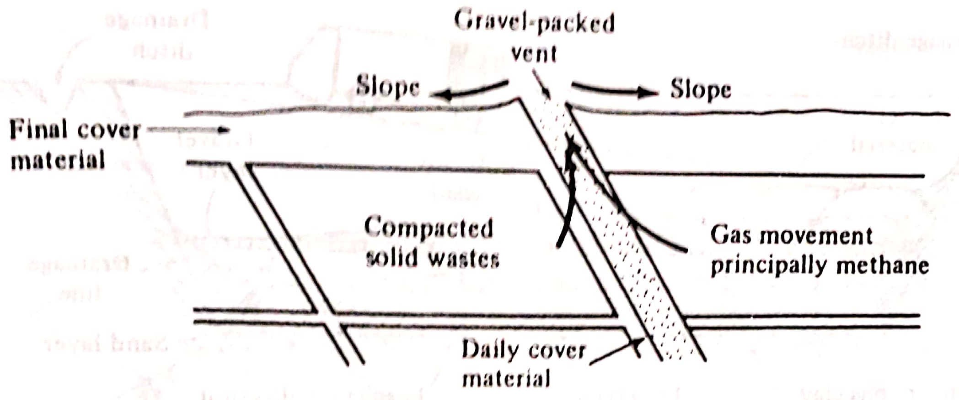
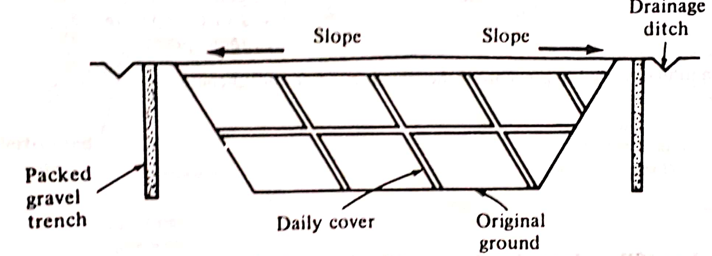
Control of Gas Movement
Typical methods for venting landfill gases:
(a) Cell
(b) Barrier

Slide 27
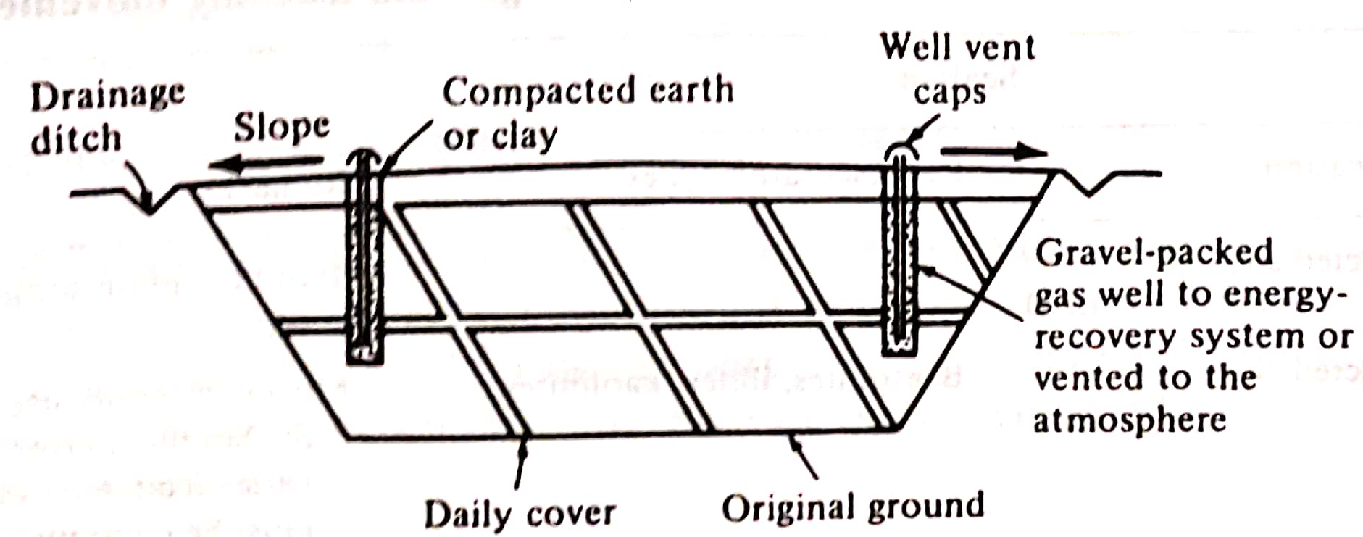
Control of Gas Movement
Typical methods for venting landfill gases:
(c) Well
(b) Barrier

Slide 28
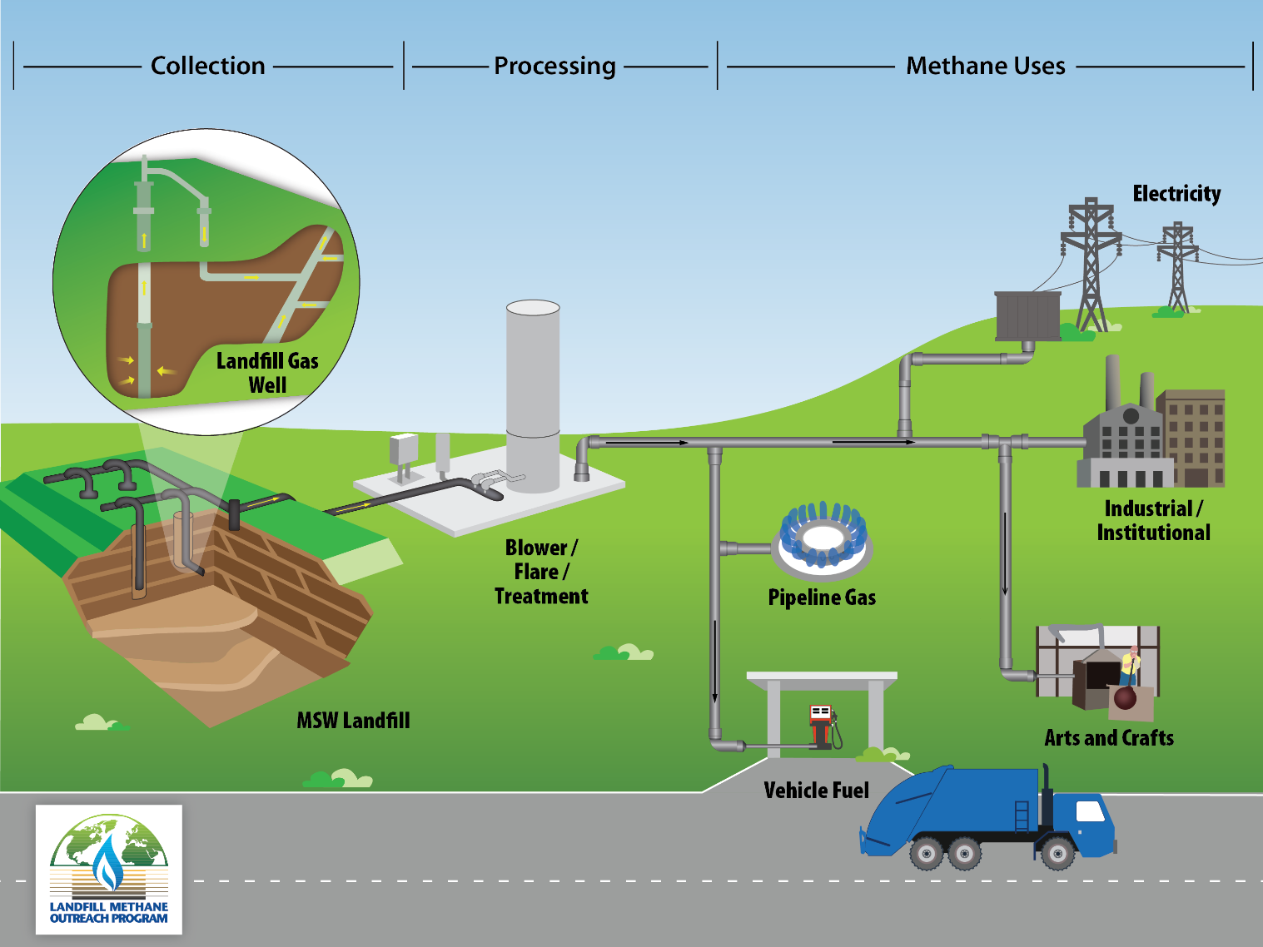
Control of Gas Movement
Control of gas movement by recovery and treatment
https://www.epa.gov/lmop/basic-information-about-landfill-gas

Slide 29
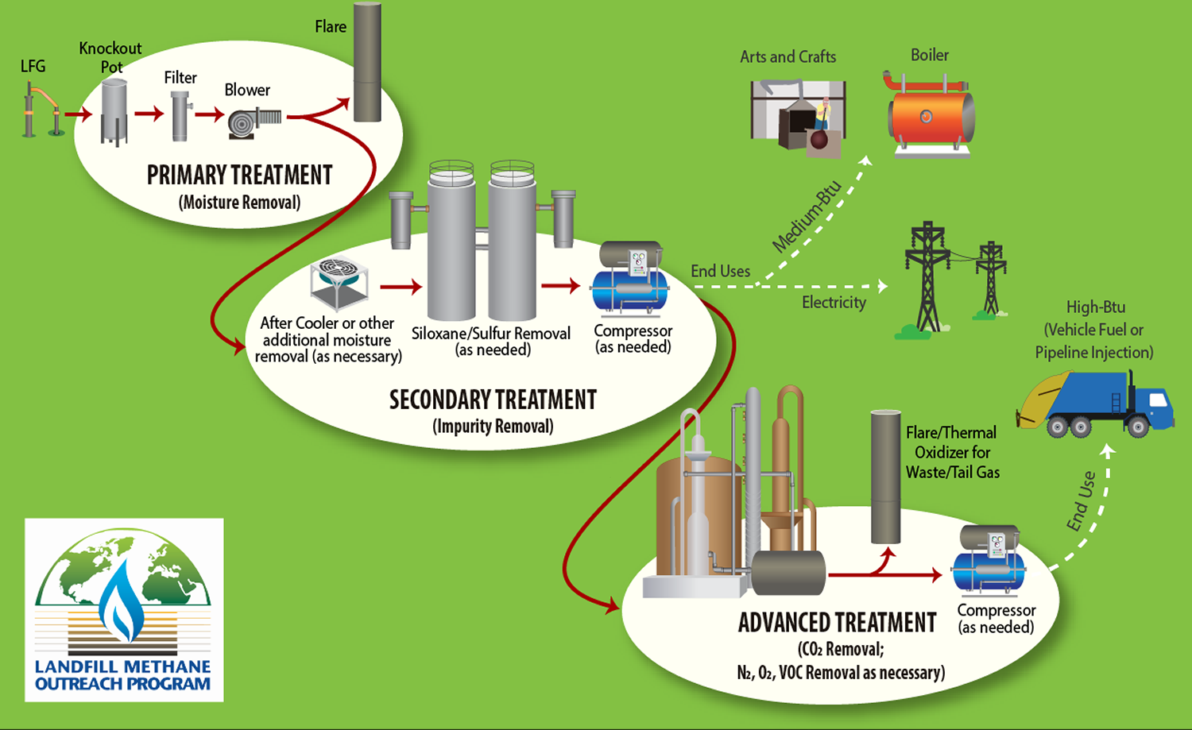
Control of Gas Movement
Control of gas movement by recovery and treatment
https://www.epa.gov/lmop/basic-information-about-landfill-gas

Slide 30
Landfill sealants for control of gas and leachate movement
Classification | Representative types | Criteria
Compacted soil | - | Should contain some clay or fine silt
Compacted clay | Bentonites, illites, kaolinites | Most commonly used; layer must be continuous and not allowed to dry and crack
Inorganic chemicals | Sodium carbonate, silicate, or pyrophosphate | Use depends on local soil characteristics
Synthetic chemicals | Polymers, rubber latex | -
Synthetic membrane liners | Polyvinyl chloride, butyl rubber, Hypalon, polyethylene, nylon-reinforced liners | Expensive, may be justified where gas is to be recovered
Asphalt | Modified asphalt, asphalt-covered polypropylene fabric, asphalt concrete | Layer must be thick enough to maintain continuity under differential settling conditions
Others | Gunite concrete, soil cement, plastic soil cement | -

Slide 31
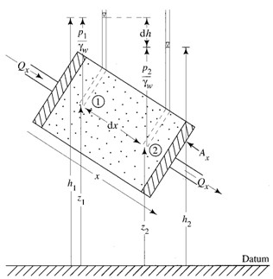
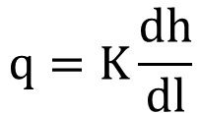
Estimating Leachate
The rate of seepage of leachate from the bottom of the landfill can be estimated by Darcy’s law:
where,
q is the Darcy velocity or discharge per unit area
K is the coefficient of permeability
or hydraulic conductivity (Darcy’s coeff.)
dh/dl is the loss of head per unit length
If we assume the material below the landfill up to the water table is saturated, and only a small layer of leachate exists at the bottom of the landfill, the leachate discharge rate per unit area is equal to the coefficient of permeability K’ (m/day).
This maximum value of discharge rate must be used for design purposes.
$$q=K\frac{dh}{dl}$$

Slide 32
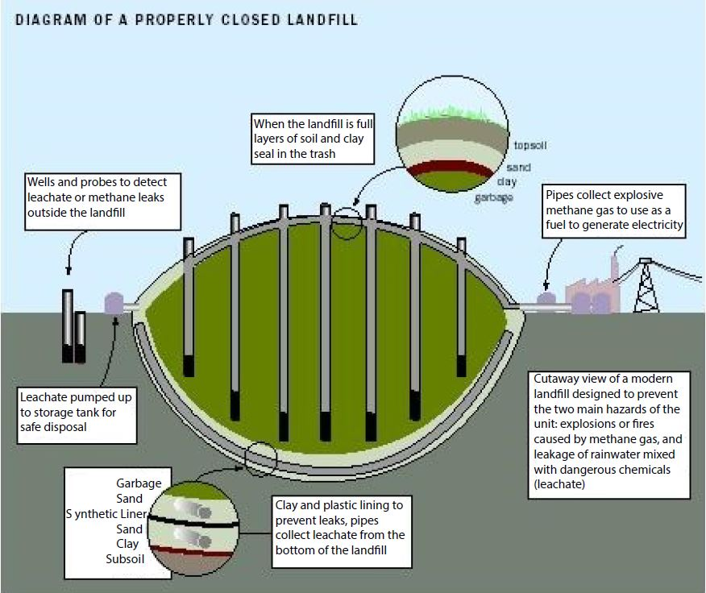
Control of Leachate Movement
https://www.epa.gov/landfills/municipal-solid-waste-landfills

Slide 33
Leachate Barrier System
The landfill must have a leachate barrier system to contain leachate and prevent the contamination of surface water and groundwater over the life of the landfill.
Pollutants with the potential to degrade the quality of groundwater must not migrate through the strata to any point beyond the boundary of the premises or beyond 150 m from the landfill footprint, whichever is smaller.
If this occurs, additional engineered controls may be required to prevent further pollutant migration. It may also be necessary to remediate the existing pollution.
The base and walls of all solid waste landfill cells should be lined with a durable material of very low permeability to form a barrier between the waste and the groundwater, soil and substrata.

Slide 34
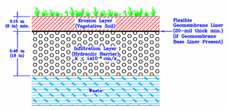
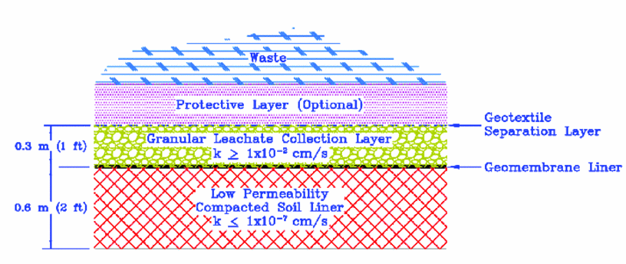
Minimum Barrier System
(a) Top Cover
(b) Bottom Barrier

Slide 35
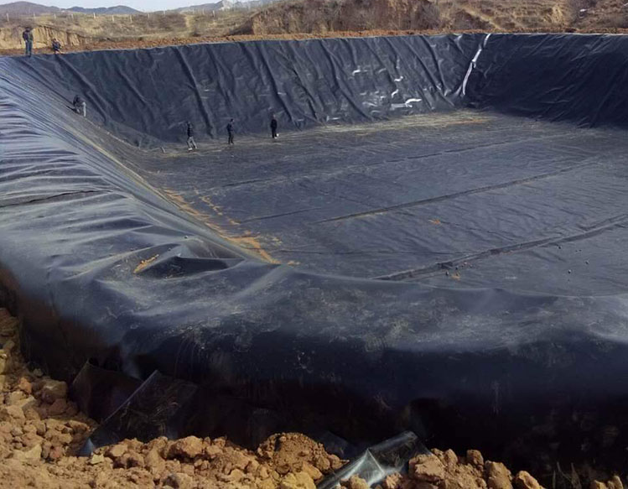
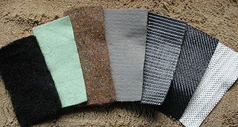
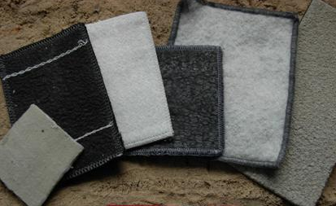
Examples of Liners
Geomembranes: Thin polymeric sheets (typically HDPE~0.6 to 2 mm thick), used to control fluid migration in a landfill. They are made from the infusion of geotextiles with asphalt, elastomer, or polymer sprays.
Geotextiles: Permeable textile structures that could be woven and nonwoven fabrics, used to protect geomembranes from puncture, and as filters, separators and occasionally as drainage media.
Geosynthetic clay liners: A layer of bentonite or other very low-permeability material supported by geotextiles and/or geomembranes, mechanically held together by needling, stitching, or chemical adhesives. form a highly impermeable barrier that often replaces thick layers of expensive compacted clay.
Geomembrane
Geotextiles
Geosynthetic clay liners

Slide 36
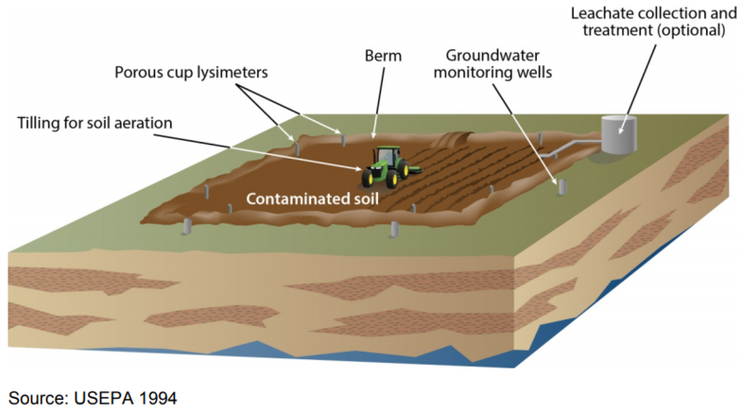
Landfarming
Biological, chemical and physical processes that occur in the surface of the soil are used to treat biodegradable industrial wastes.
When organic wastes are added to soil, they are subjected simultaneously to the following processes:
Bacterial and chemical decomposition
Leaching of water soluble components in the original wastes and from the decomposition products
Volatilization of selected components
Typical Landfarming Operation
https://www.enviro.wiki/index.php?title=Landfarming

Slide 37
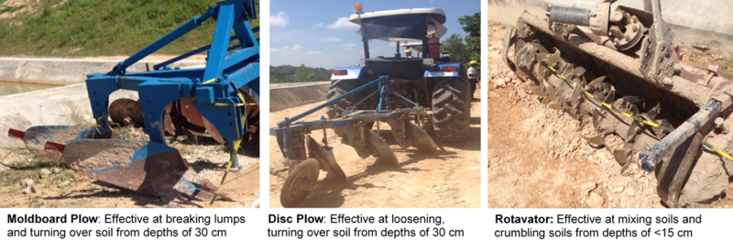
Landfarming
The material to be treated is incorporated into surface soil.
Naturally occurring microbes in the soil and waste material transform the organic contaminants to carbon dioxide, water and biomass.
Factors that should be considered:
Composition of the waste
Compatibility of wastes and soil micro-flora
Environmental requirements including oxygen, temperature, pH and inorganic nutrients
Moisture content of the solid waste mixture
Typical Landfarming Equipment
https://www.enviro.wiki/index.php?title=Landfarming

Slide 38
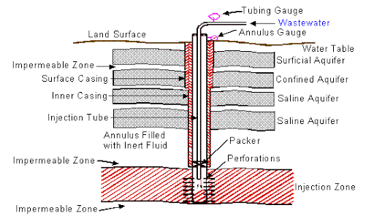
Deep-Well Injection
Injecting wastes deep in the ground into permeable rock formations.
Typically used for liquid wastes and hazardous wastes that are difficult to treat and disposed by conventional methods.
Chemical, petrochemical and pharmaceutical wastes are most commonly disposed wit this method.
http://web.deu.edu.tr/atiksu/ana58/deepwell.html

